Slide 1


MICROTRON INCORPORATED
2025 OVERVIEW PRESENTATION
______________________
GOVERNMENT AND MILITARY FOCUS
Private and Confidential

Slide 2
Company Overview
Microtron Corporation is a leader in Artificial Intelligence (AI), specializing in Autonomous Systems and Machine Learning (ML) solutions. We offer expert consulting in Data Analytics, Internet of Things (IoT), and Natural Language Processing (NLP), tailored to meet government specifications and ensure compliance with federal requirements. Our extensive expertise spans government, military, healthcare, and academia, where we provide advanced concept design and technology development. By collaborating closely with industry partners, we drive innovation, enhance operational efficiency, and supporting mission-critical applications throughout all 5 phases of the DoD Acquisition Life Cycle
Conceptual Design
Prototyping
Functional Analysis
Validation
Development
We apply our multidisciplinary expertise to develop innovative and tailored concepts that address specific requirements and objectives
Utilizing advanced modeling and prototyping techniques, we create high-fidelity mockups that accurately represent the form and functionality of proposed designs.
Our team conducts comprehensive functional analysis to ensure that proposed concepts meet performance criteria and adhere to industry standards and specifications.
We collaborate closely with stakeholders to validate requirements and refine concepts based on feedback and evolving needs.
Our team focuses on developing innovative technologies with the goal of commercialization or partnership opportunities.
Private and Confidential

Slide 3
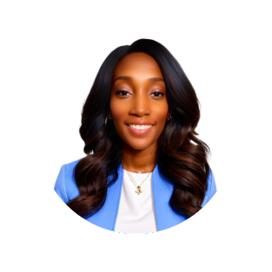

Leadership Team
Bisa Peterson, Chief Executive Officer
Bisa Peterson is an accomplished entrepreneur and visionary inventor with a strong foundation in nanotechnology, biotechnology, and artificial intelligence. With over a decade of experience, she has developed more than 133 innovative concepts and excelled in utilizing AutoCAD for designs and pioneering laser processing methods for biomaterials. Her career is marked by leadership roles in product development and strategic operations across various technology sectors, and she holds a degree in Physics with a minor in International Studies from The University of Southern Mississippi.
Dr. Timothy M. Weil, BCBA-D, Chief Operating Officer
Dr. Timothy Weil, BCBA-D, brings an expansive career in behavior analysis starting from 1993, with a focus on addressing pediatric behavioral challenges and academic difficulties. Earning his Ph.D. in behavioral psychology from the University of Nevada, Reno, he specialized in pediatric issues, leading to influential roles teaching in graduate Behavior Analysis programs at Florida State University and the University of South Florida. Here, he also spearheaded early childhood autism programs and academic initiatives. Beyond academia, Dr. Weil is recognized for his speaking engagements and workshops on advanced behavioral techniques, alongside his scholarly contributions through published works and participation on editorial boards of behavioral science journals. His comprehensive expertise and dedication to the field embody his profound impact on behavior analysis and its application.
Private and Confidential

Slide 4


Leadership Team
Parker Bidigare, Chief Technology Officer
Parker Bidigare is a software engineer with a decade of experience spanning academia, government, and pharmaceuticals, distinguished by his profound contributions to robotics and artificial intelligence. His expertise encompasses a wide range of technical skills, including electronic circuit design, microcontrollers, 3D graphics, neural networks, and vision processing. His commitment to continuous learning and innovation has led him to continually exploring new avenues to apply his knowledge and skills.
Jeff Meiskin, Chief Financial Officer
Jeff Meiskin is a seasoned Senior Financial Executive with over 25 years of strategic leadership across finance, operations, and management in small to medium-sized entrepreneurial firms. He excels in guiding companies through transformation and growth phases, adept at capital raising and M&A activities. Jeff has contributed his financial and operational expertise across a diverse range of sectors, notably within Consumer Goods (including Apparel), Financial Services, Technology, Real Estate, and Manufacturing.
Private and Confidential

Slide 5
DoD Acquisition Life Cycle
Material Solutions Analysis (MSA)
Technology Maturation & Risk Reduction
(TMRR)
Engineering & Manufacturing Development
(EMD)
Production & Deployment
(P&D)
Operations & Support
(O&S)
Pre- System Acquisition
System Acquisition
Sustainment
Phase Objectives
MSA: Conduct analysis and other activities needed to choose the concept for the product that will be acquired
TMRR: Reduce technology, engineering, integration, and life-cycle cost risk to the point where a decision to enter EMD can be made with confidence
EMD: Achieve Initial Operational Capability (IOC) and demonstrate an affordable, supportable, interoperable, and producible system in its intended environment
P&D: Achieve Full Operational Capability (FOC) that satisfies the mission needs
O&S: Execute the product support strategy, satisfy material readiness and operational support performance requirements, and sustain the system over its life cycle
Private and Confidential
Notes:
MSA: Conduct analysis and other activities needed to choose the concept for the product that will be acquired
TMRR: Reduce technology, engineering, integration, and life-cycle cost risk to the point where a decision to enter EMD can be made with confidence
EMD: Achieve Initial Operational Capability (IOC) and demonstrate an affordable, supportable, interoperable, and producible system in its intended environment
P&D: Achieve Full Operational Capability (FOC) that satisfies the mission needs
O&S: Execute the product support strategy, satisfy material readiness and operational support performance requirements, and sustain the system over its life cycle

Slide 6
Past Performance
Material Solutions Analysis (MSA)
Avastar and Datafeel:
Conducted an analysis of their patent
Production & Deployment
(P&D)
Nano-Research Inc:
Achieved FOC for a COVID-19 Virus Deactivation Solution that used UV light to reduce the risk of infection
Technology Maturation & Risk Reduction
(TMRR)
Dotcom:
Executed a Technology Readiness Assessment (TRA) and offered remedies for previously identified technical challenges
Operations & Support
(O&S)
Ective:
Helped increase sales and
expand into an international market
Engineering & Manufacturing Development
(EMD)
UC San Diego:
Developed an affordable and executable manufacturing process for Zinc/Lithium batteries
Other Contract Based Work
Itarra Tractor:
Facilitated technology validation and served as the project manager for the testing site
Private and Confidential
Notes:
MSA: Conduct analysis and other activities needed to choose the concept for the product that will be acquired
TMRR: Reduce technology, engineering, integration, and life-cycle cost risk to the point where a decision to enter EMD can be made with confidence
EMD: Achieve Initial Operational Capability (IOC) and demonstrate an affordable, supportable, interoperable, and producible system in its intended environment
P&D: Achieve Full Operational Capability (FOC) that satisfies the mission needs
O&S: Execute the product support strategy, satisfy material readiness and operational support performance requirements, and sustain the system over its life cycle

Slide 7
Proprietary Technology
PAD & PAD Pro Home Automation Powered by JARVIS
The foundational model, Jarvis, empowers PAD & PAD Pro
Jarvis is a comprehensive home automation system operated through voice commands, inspired by Tony Stark’s AI companion
Jarvis recognizes and adapts to user’s unique speech patterns and vocabulary, enhancing user experience and ease of interaction
Features include: Open source application system, Natural Language Processing (NLP), Emotional AI, Enhanced connectivity
iMagic & IMagic Pro - 4K Holographic Fog Projector
iMagic aims to deliver fully immersive and interactive experiences reminiscent of theme parks, but in the comfort of your own home
Features include: Eye tracking, Biometric security, Object recognition, Leap motion technology, 3D rotary overlay and power source system for 3D augmentation, Integration into PAD & Pad Pro
iView - Smart Glasses Compatible with ABA Observational Software
iView provides 3D viewing capabilities at your fingertips
These smart glasses, designed specifically for the Healthcare sector, support guide surgeries, psychological observations, file sharing, remote communication, dual interfacing, and interactivity
Compatible with a wide range of AR applications, iView smart glasses leverage leap motion technology, allowing users to interact using hand and finger motions
Private and Confidential

Slide 8
Proprietary Technology
iShield - Smart Civilian Body Camera
iShield is poised to shape the future of personal safety and meet unique individual needs
The sleek, modernized design enables multi-positional viewing and balances stealth, style, and security
Features include: 360-degree viewing angles, live feed streaming, voice detection, AI empowered standalone security system, Push-to-call emergency management connector, integration with Android/iOs mobile devices, integration with in-car and interview room recording systems
iSight - Camera Lens
iSight is the camera lens that is utilized for iShield and other Microtron technologies
Features include: visual clarity in low light conditions, noise reduction technology, infrared visualization
iShadow - Evidence Management Software
iShadow is a custom secure evidence management solution that integrates with iShield and other recording systems
Due to its ability to efficiently manage and organize digital evidence, iShadow has the potential to streamline workflows for law enforcement agencies, legal professionals, private citizens, and other stakeholders
Private and Confidential

Slide 9
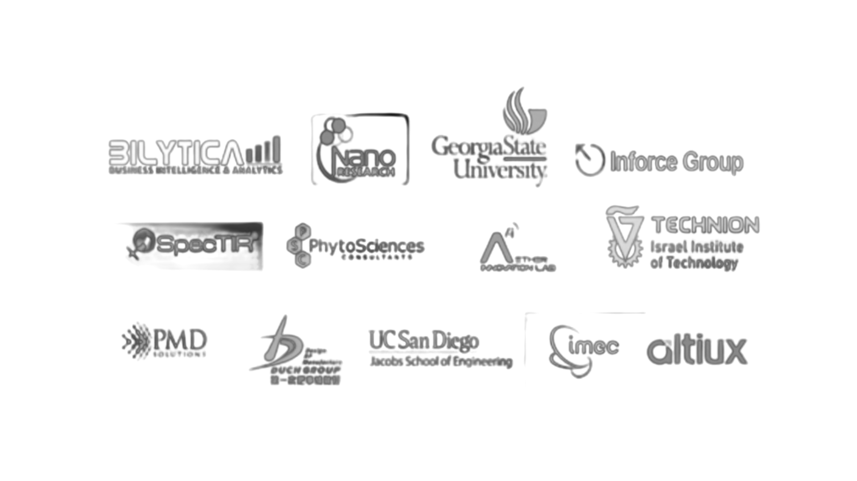
Microtron Ecosystem
Private and Confidential

Slide 10
NAICS Codes
Manufacturing
315990 - Apparel Accessories and Other Apparel Manufacturing
332510 - Hardware Manufacturing
Technology and Software
511210 -Software Publishers
541511 - Custom Computer Programming Services
541519 - Other Computer Related Services
Engineering and Design
541330 - Engineering Services
541430 - Industrial Design Services
Consulting and Research
541618 - Other Management Consulting Services
541690 - Other Scientific and Technical Consulting Services
541714 - Research and Development in Biotechnology
541715 - Research and Development in Physical, Engineering, and Life Sciences (except Biotechnology)
Private and Confidential

Slide 11
Appendix
Private and Confidential

Slide 12
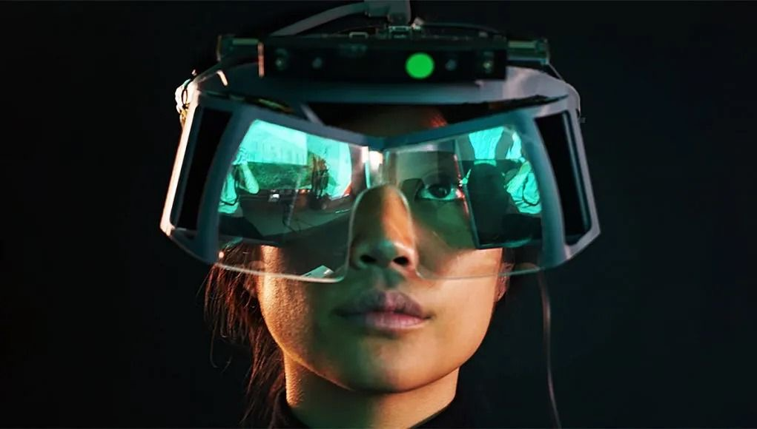
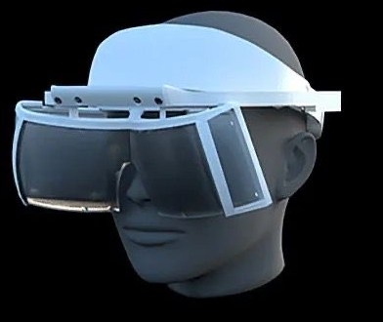
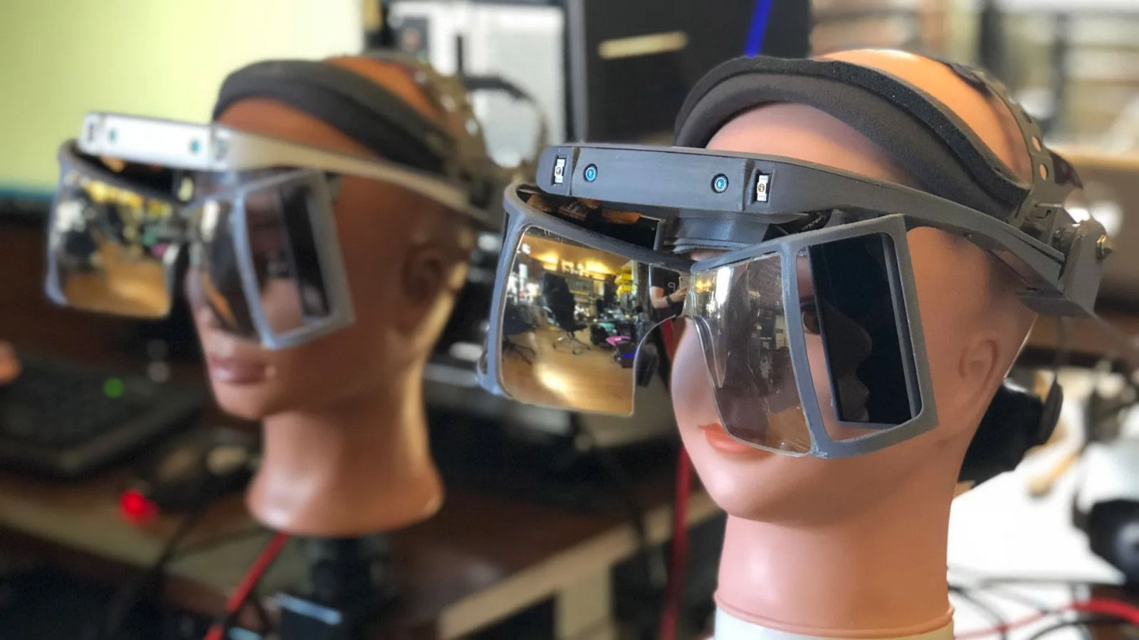
CONCEPT TO PROTOTYPE:
DESIGNING AUGMENTED REALITY (AR) GLASSES
Mockup
3D Model
Prototype
Private and Confidential

Slide 13

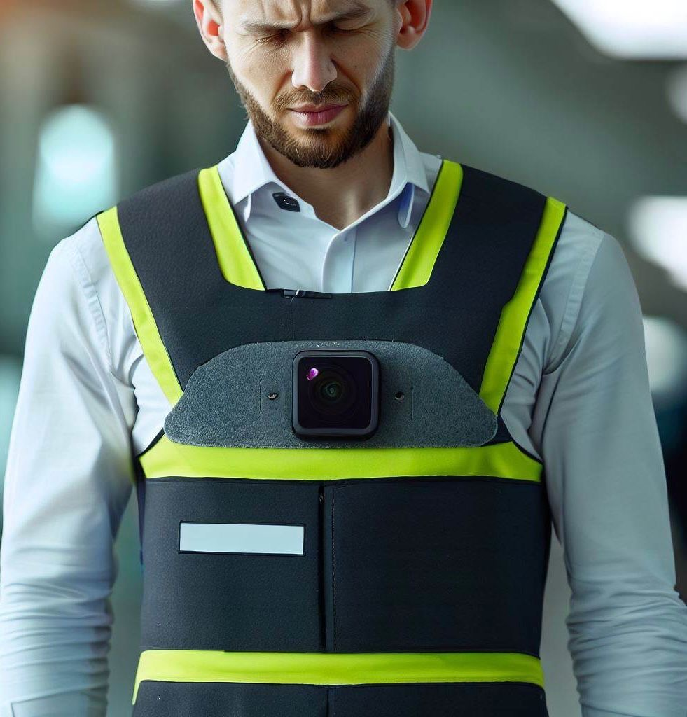
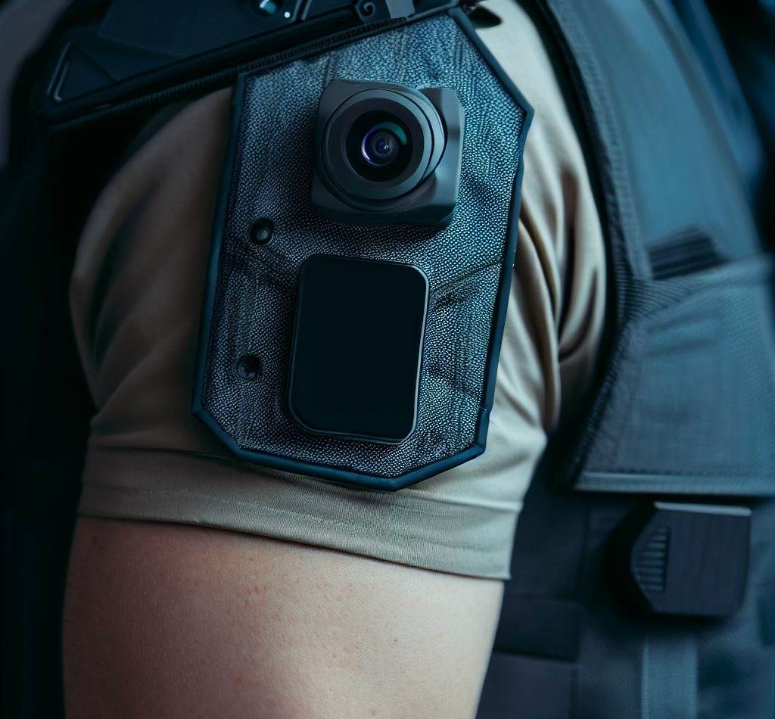

DESIGN
CONCEPTS
Private and Confidential

Slide 14
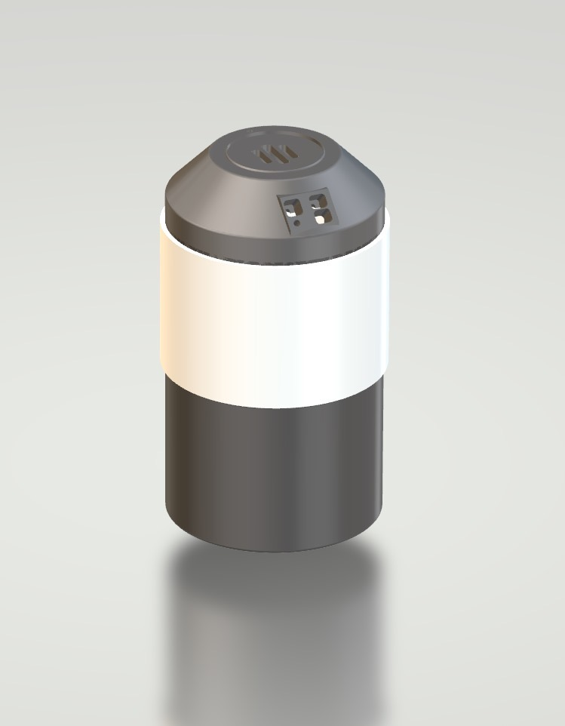
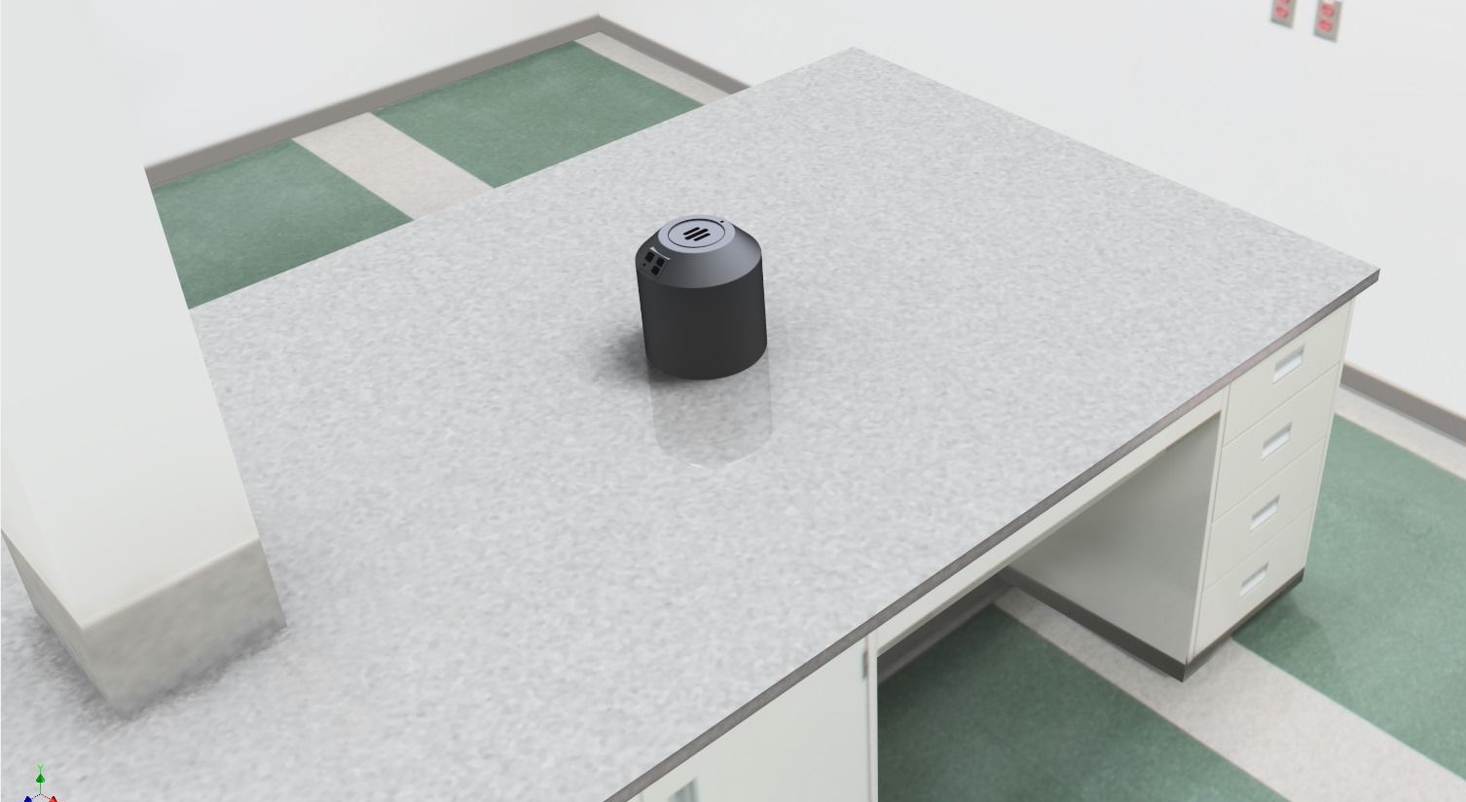
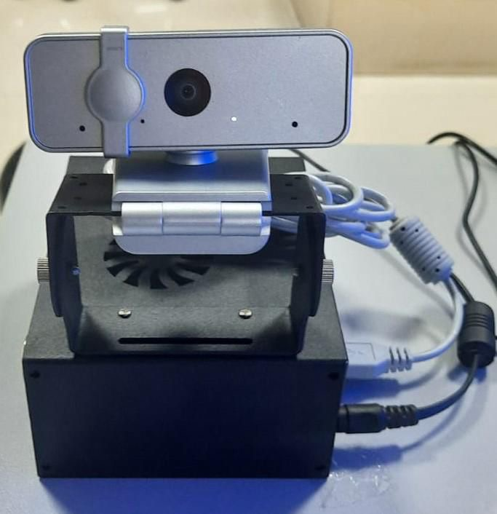
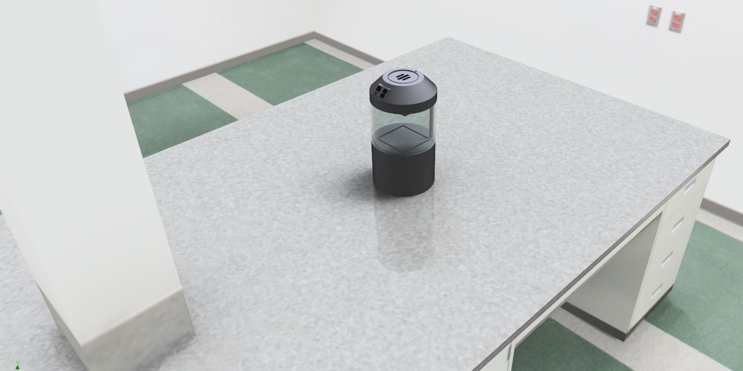
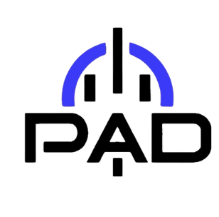
PAD HOME AUTOMATION POWERED BY JARVIS AI SOFTWARE
3D MODELS
INTERNAL
COMPONENTS
RAPID PROTOTYPING
IN PROGRESS
(SYRACUSE UNIVERSITY)
Private and Confidential

Slide 15
PRODUCT DEMOS
AVAILABLE UPON REQUEST
Private and Confidential

